Slide 1
Integration for Physics Based Animation

Slide 2
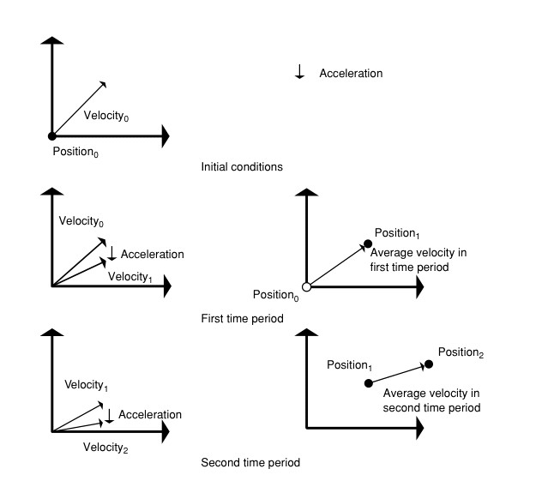
Integration
Given acceleration, compute velocity & position by integrating over time

Slide 3
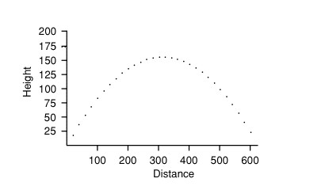
Projectile – given initial velocity under gravity

Slide 4
Integration – derivative field
For arbitrary function, f(t)

Slide 5
Euler Integration
For arbitrary function, f(t)

Slide 6
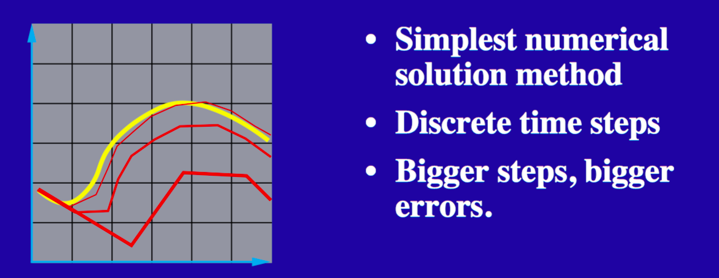
Euler’s Method
$$f\left(t+∆t\right)=f\left(t\right)+∆t∙f^{′}(t)$$

Slide 7
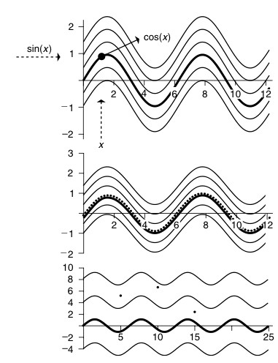
Step Size

Slide 8
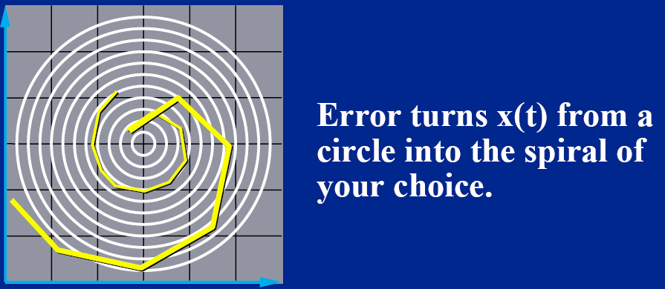

Euler’s Method – Problem 1: Inaccuracy
Consider circular 2D vector field
$$x\left(t+∆t\right)=x\left(t\right)+∆t ∙x′(x,t)$$
$∆t ∙x′(x,t)$ : straight line segments, tangential to circles – outward spiral
$∆t→0$ : slows outward drift, does not eliminate it

Slide 9
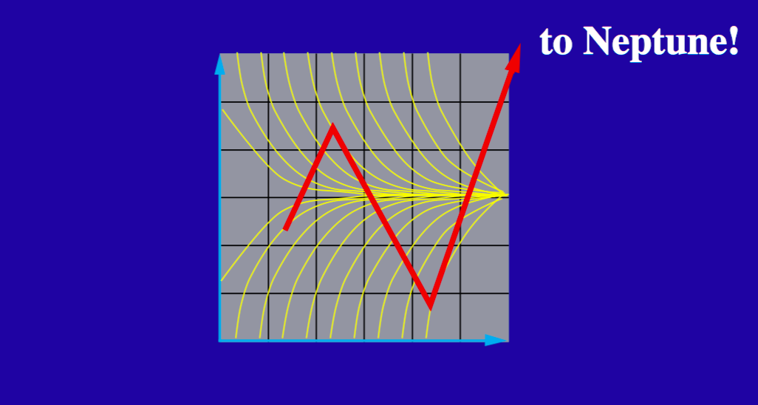

Euler’s Method – Problem 2: Stability
Consider : $x^{′}(t)=−k∙x\left(t\right)$
Analytical solution: $x\left(t\right)=exp(−k∙x(t))$
$x\left(t+∆t\right)=x\left(t\right)+∆t∙x′(t)$
$∆t$ small: ok
$∆t>1/k$ , $\left|∆t∙x^{′}(t)\right|>\left|x\left(t\right)\right|$ : Oscillation
$∆t>2/k$ : Divergence, blow up

Slide 10
Numeric Integration Methods
(explicit or forward) Euler Integration
2nd order Runga Kutta Integration (Midpoint Method)
4th order Runga Kutta Integration
Implicit (backward) Euler Integration
Semi-implicit Euler Integration

Slide 11
Runge Kutta Integration: 2nd order -- Midpoint Method
For unknown function, f(t); known f ’(t)

Slide 12
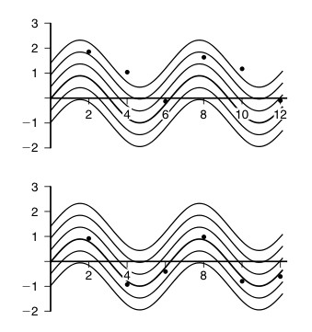
Step Size
Euler Integration
Midpoint Method

Slide 13
Runge Kutta Integration: 4th order
For unknown function, f(t); known f ’(t)

Slide 14
Implicit Euler Integration
For arbitrary function, f(t), find next point whose derivative updates last value to this value: required numeric method (e.g. Newton-Raphson)
Search for point such that negative of tangent points back at original point

Slide 15
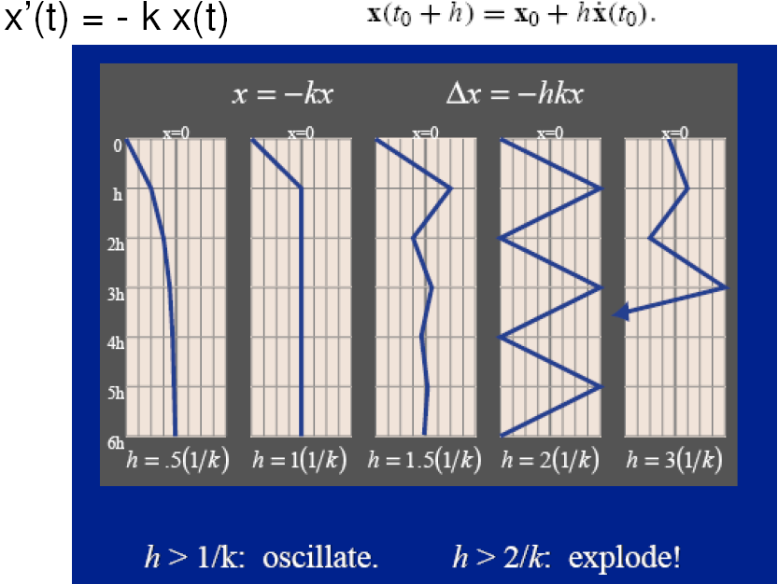
Example

Slide 16
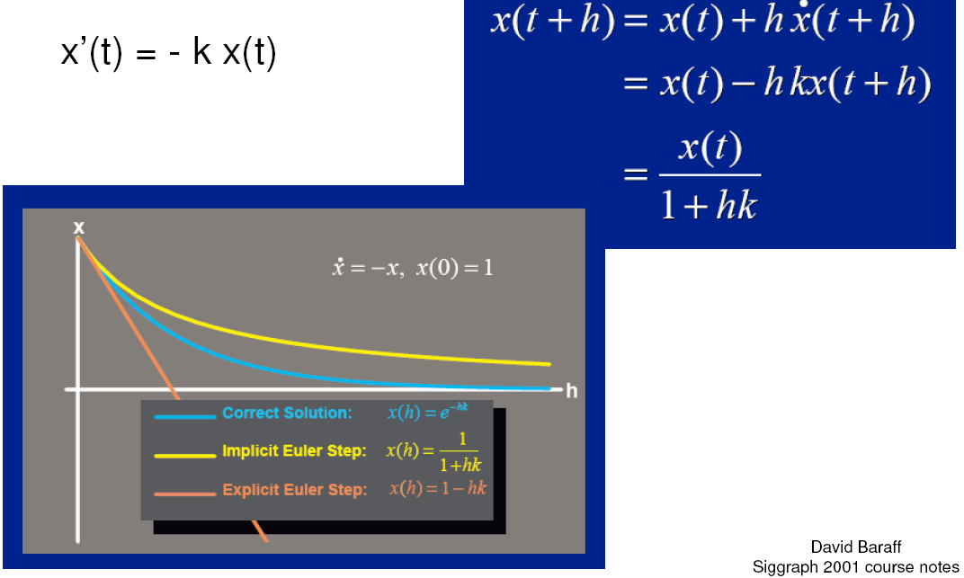
Example

Slide 17
Differential Equation Initial boundary problem
(explicit/forward)
Euler method
(implicit/backward)
Euler method
e.g. linearize f’ and use Newton-Raphson

Slide 18
Semi-Implicit Euler Integration

Slide 19
Methods Specific to Update positon from acceleration
Heun Method
Verlet Method
Leapfrog Method

Slide 20
Heun Method

Slide 21
Verlet Method

Slide 22
Leapfrog Method

